Slide 1
Datasets and how to get data
Common ways to get data

Slide 2
How to get datasets ?
There are many ways to have data for a Data Scientist
Somebody give us: luck!
By using API
By querying a database (MySQL, Vertica…)
Using Scraping techniques

Slide 3
API calls (Application programming interface)
Services like Instagram, Facebook, Wikipedia have a lot of information stored in databases. Usually they give us the possibility to “ask” programmatically for data via API calls.
The services we are asking data to usually can control “how much” data we can have, limiting our calls with a certain “rate limit” (for example: we can do 1000 calls / hour)
Example of services: Wikipedia, Wheather, Instagram, Facebook…
The access to data via API is allowed (generally) after they give us a “token” = like a password we must show to have data and used to track our requests.
The token is not always needed (depends on the service)

Slide 4

API calls
When we talk about API, you usually hear about:
Endpoint: it is the URL where to request the data (es: http://api.open-notify.org/astros.json )
API REST: the most common APIs (to get data)
The response is usually in a special format, called JSON: it is a special format of data type, VERY similar to a dictionary in Python.
We think it is more easy to see an example...NASA!

Slide 5
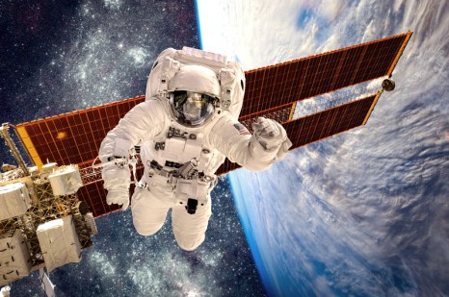
API from NASA
We see an example of API usage, the information are public and free. We are able to get information from NASA in real time.
We can get information like:
Who is in the space now
Position of ISS craft
LINK
ENDPOINT: http://api.open-notify.org/iss-now.json
Notebook: NASA_WIKI_INSTAGRAM.ipynb
API tutorial: LINK
Link to Geopandas Tutorial: LINK

Slide 6


Wikipedia API
Instagram API
Wikipedia has free API
Notebook: NASA_WIKI_INSTAGRAM.ipynb
Instagram can give us information
Notebook: NASA_WIKI_INSTAGRAM.ipynb
https://www.wikidata.org/wiki/Wikidata:SPARQL_query_service/queries/examples
API tutorial: LINK
API tutorial: LINK

Slide 7
Open Notebook API Examples in 13.2

Slide 8
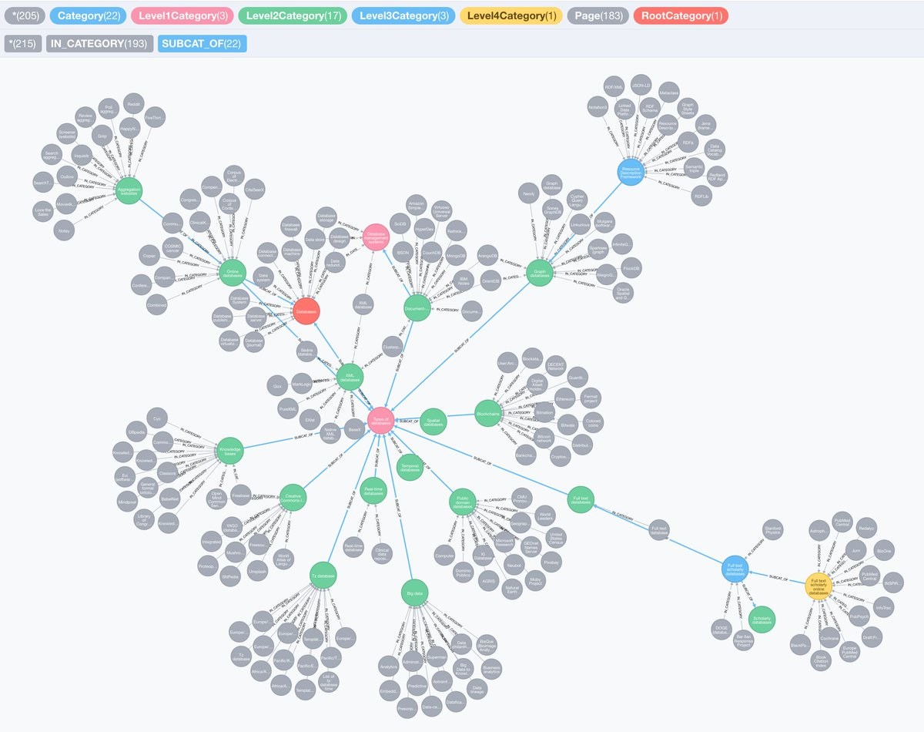
SPARQL from Wikipedia Graph
Wikipedia is a Graph made of nodes and edges (links). SPARQL is a language to get information directly from the knowledge graph.
LINK to SPARQL examples
SPARQL is VERY powerful!!!

Slide 9

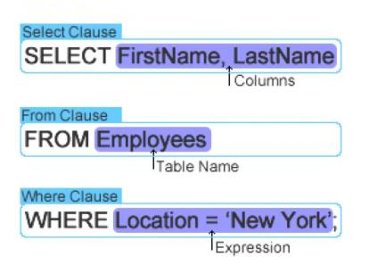


Queries to a Database
In this case, we must have the credentials to be able to get information. Without credentials, it is impossible to get information from a database.

Slide 10


Scraping
Scraping is a technique to get data via web but “scraping” information to HTML pages.
In this case we are not using API, but driving the browser to navigate the web and open pages and get information by reading the HTML code on the page.
Selenium
Scrapy

Slide 11
Launch the ANSA scraper!

Slide 12
Datasets
What they are

Slide 13
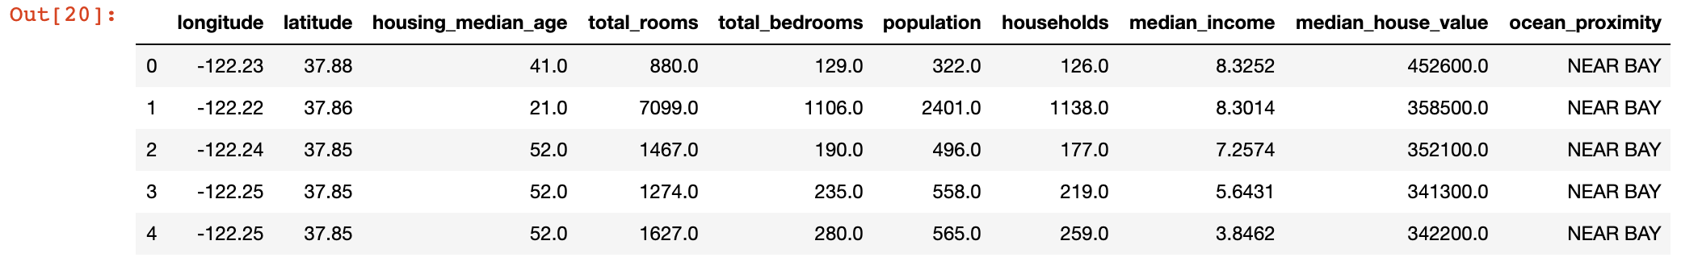
Datasets
A dataset is “simply” a table with data.
In Machine Learning it is very common to indicate:
Samples (to indicate the rows)
Features (to indicate the columns)
The number of samples is indicated generally with “m”
The number of features is indicated generally with “n”

